Slide 1
Lecture 18
Vision for the Universal Human Order

Slide 2


Slide 3
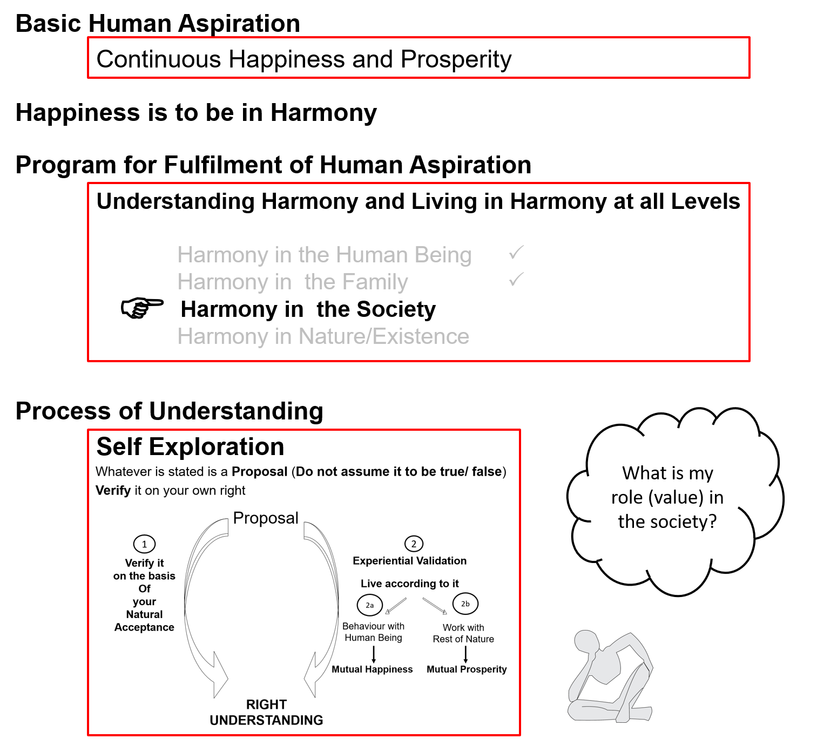

Slide 4
Universal Human Order
We explored:
Goal of human being living in society (human goal)
The dimensions or systems required to achieve the human goal
In this lecture, we will recap these two and discuss the
Scope of the systems
We will also discuss more details of some of the societal systems which will ultimately lead to the universal human order

Slide 5
Harmony in the Society (lekt esa O;oLFkk)
Human Goal (ekuo y{;)
Human Order ¼ekuoh; O;oLFkk½
Systems / Dimensions ¼vk;ke½
  1. Education – Sanskar
  2. Health – Self-regulation
  3. Production – Work
  4. Justice – Preservation
  5. Exchange – Storage
Right Understanding & Right Feeling
Prosperity
Fearlessness
(Trust)
Co-Existence
(mutual fulfilment)
1
Happiness
2
3
4
In Every Individual
In Every Family
In Society
In Nature/ Existence
1
2
3
4
1
2
4
3
4
2
3

Slide 6
Harmony in the Society (lekt esa O;oLFkk)
Human Goal
Human Order ¼ekuoh; O;oLFkk½
Systems / Dimensions ¼vk;ke½
  1. Education – Sanskar
  2. Health – Self-regulation
  3. Production – Work
  4. Justice – Preservation
  5. Exchange – Storage
Right Understanding & Right Feeling
Prosperity
Fearlessness
(Trust)
Co-Existence
(mutual fulfilment)
1
Happiness
In Every Individual
In Every Family
In Society
In Nature/ Existence
1
2
3
4
1a. Education – To develop the right understanding of the harmony at all levels of our being – from self to the entire existence (individual, family, society, nature/existence)
1b. Sanskar – The commitment, preparation and practice of living in harmony. Preparation includes learning the skills and technology for living in harmony at all levels – from self to the entire existence (individual, family, society, nature/existence)
1

Slide 7
Education-Sanskar
Education = Developing Right Understanding
Sanskar = Commitment/ Preparation/ Practice for Right Living
Preparation includes Learning Right Skills & Technology
Development of the competence to live with Definite Human Conduct
Discipline to Self Discipline
Right understanding, i.e. wisdom or clarity about what to do as a human being – in oneself, family, society, nature…
Right feeling – the capacity to live in relationship with the other human beings – in family, society…
Right skills for prosperity, i.e.
    The capacity to identify the need of physical facility
    The skills & practice for sustainable production of more than what is required (by way of labour using cyclic, mutually enriching process)
    The feeling of prosperity

Slide 8
Process of Developent – In an environment of Relationship
Assuming ekuuk
Knowing
tkuuk
Imitate vuqlj.k
Family
ifjokj
School
fo|ky;
University
fo”o&fo|ky;
Society
lekt
Follow vuqdj.k
Next Generation
Obedience/Discipline
vkKkikyu@vuq'kklu
Relationship
laca/k
Right
lgh
Self-verif
Tkk¡p
Self Discipline (10…)
Lo&vuq'kklu
Self-confidence
vkRefo”okl
Every next generation is more developed
In harmony within
In harmony with family
In harmony with society
In harmony with nature/existence

Slide 9
Process of Developent – In an environment of Domination
Assuming ekuuk
Imitate vuqlj.k
Family
ifjokj
School
fo|ky;
University
fo”o&fo|ky;
Society
lekt
Follow vuqdj.k
Next Generation
Obedience/Discipline
vkKkikyu@vuq'kklu
Domination
'kklu
Self-verif
Tkk¡p
Wrong
xyr
Arbitrariness euekuh
Every next generation may be less developed
In more contradiction within
In more opposition with family
More struggle in society
More conflict with nature/ existence
Opposition nz®g
Revolt fonz®g (~teenage)
Struggle laÄ‘kZ
War ;q)

Slide 10
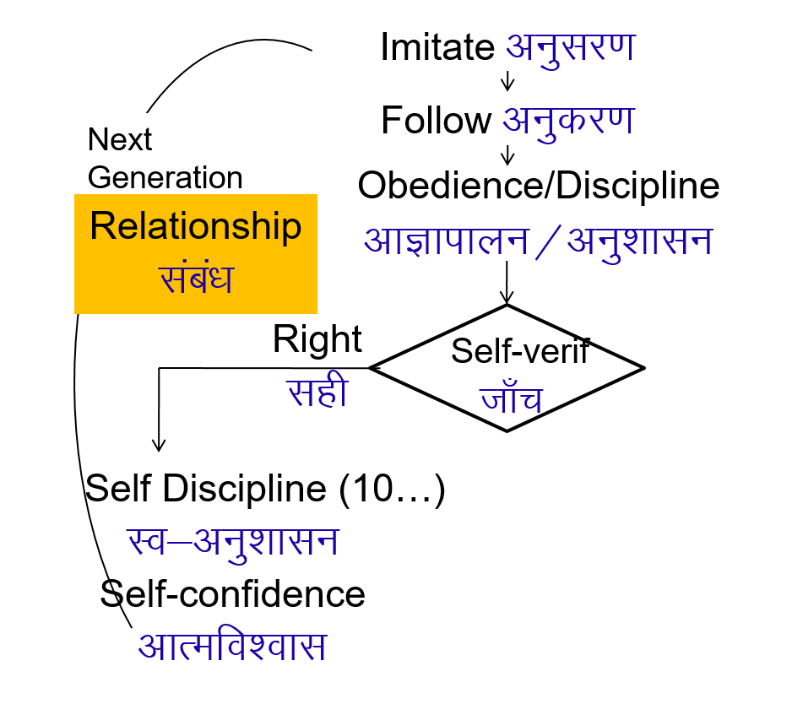
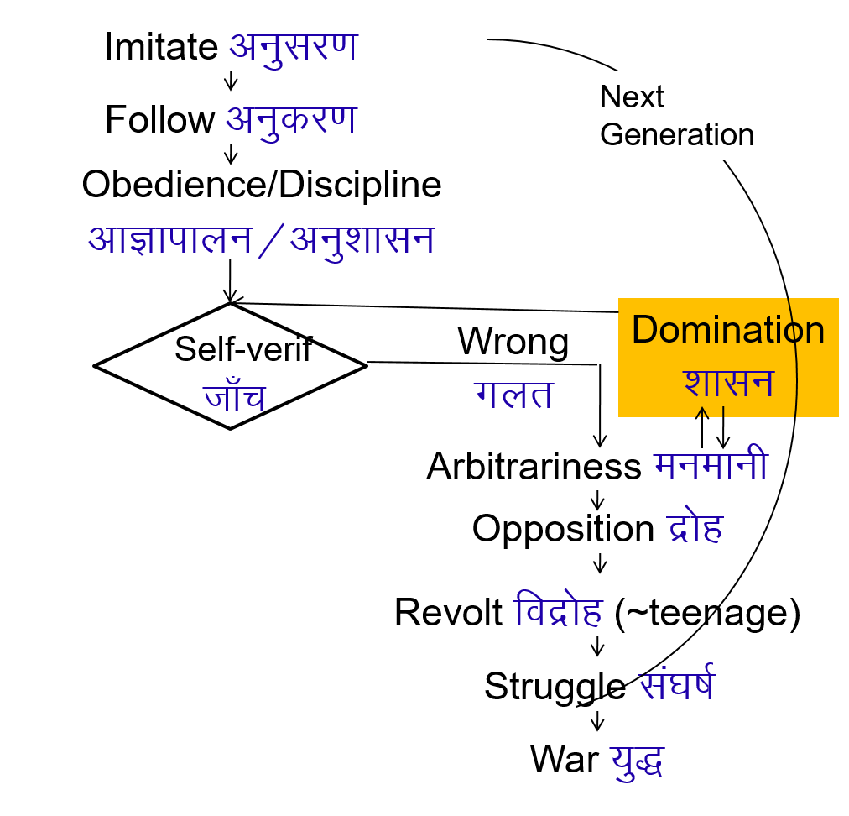

Process of Developent – Relationship Process of Developent – Domination
In an environment of Relationship
With parents and teachers having right understanding and right feeling
In an environment of Domination
With parents and teachers lacking right understanding and right feeling

Slide 11
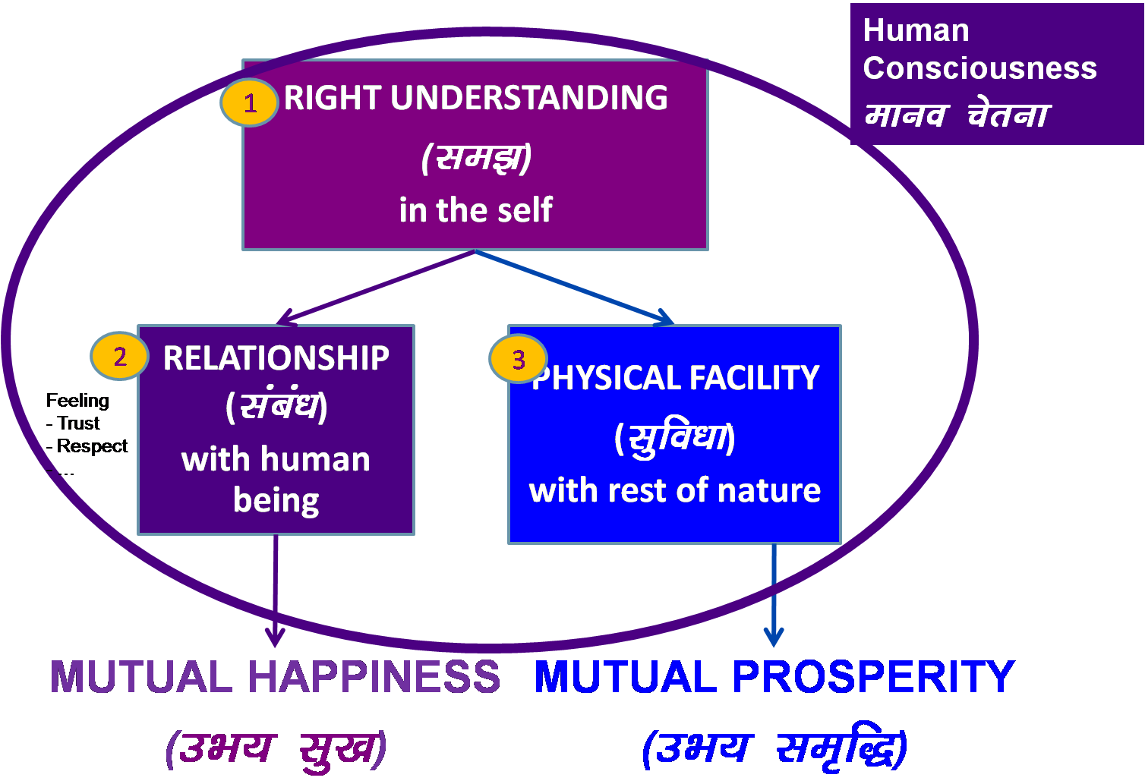
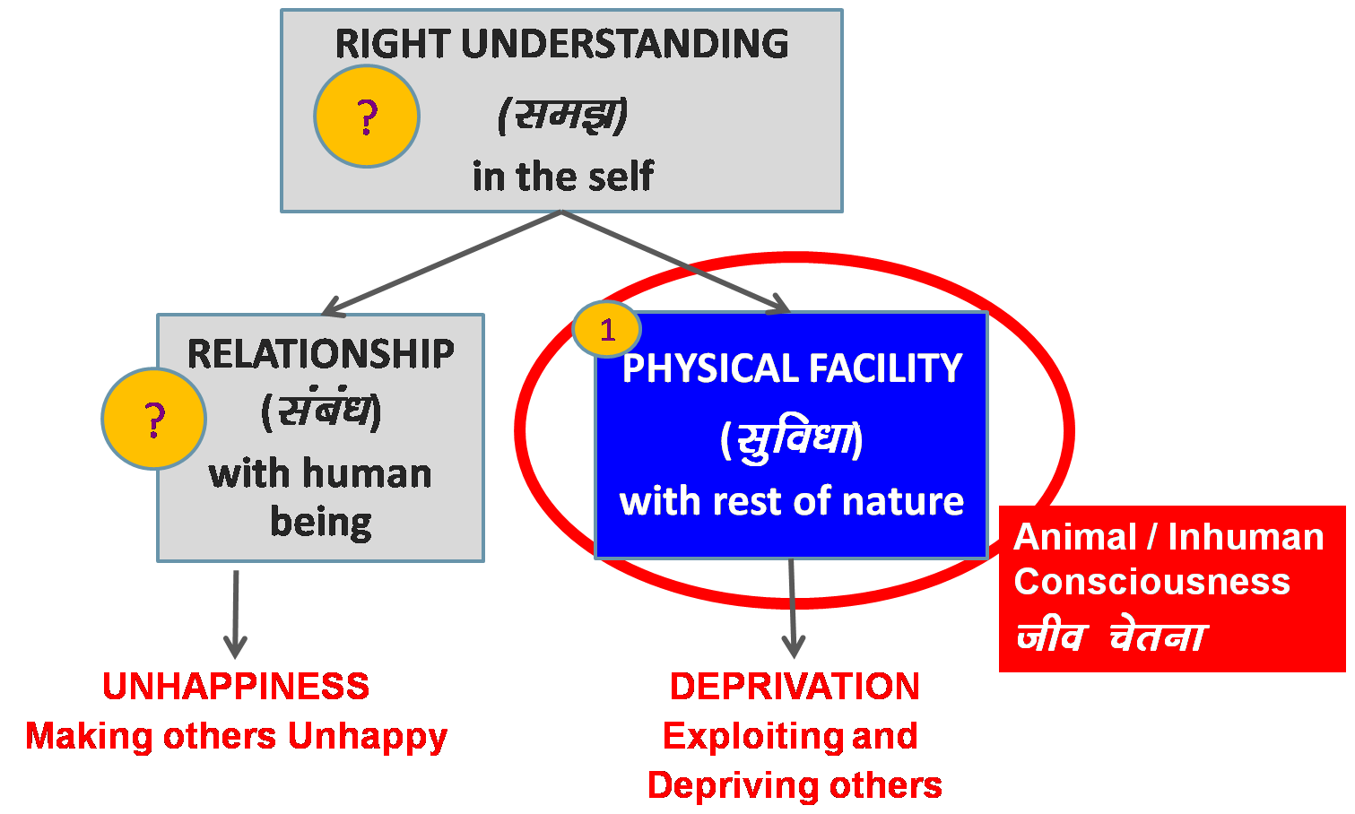
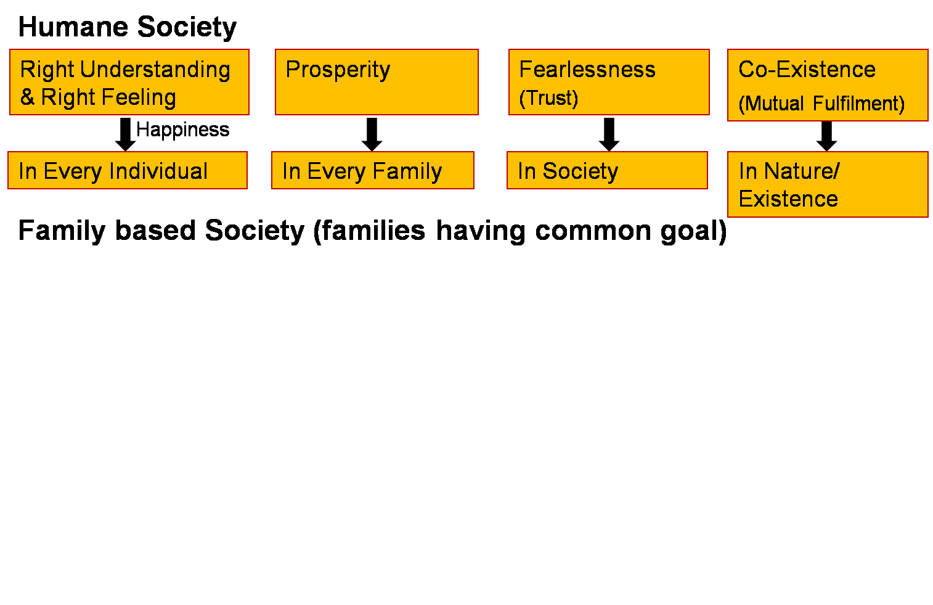
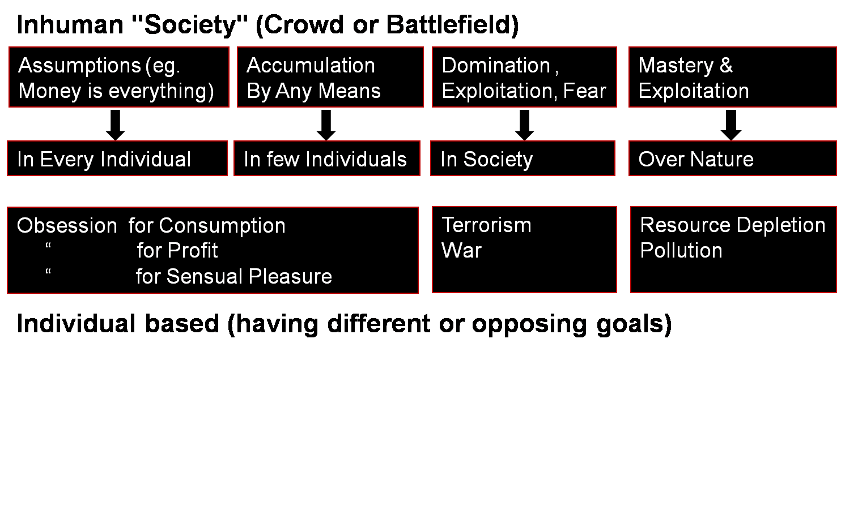
Human Education
Next generation has improved
- Understanding
- Feeling
Human Education
Personal Transformation
Societal Transformation
Transformation& Progress
laØe.k&fodkl

Slide 12
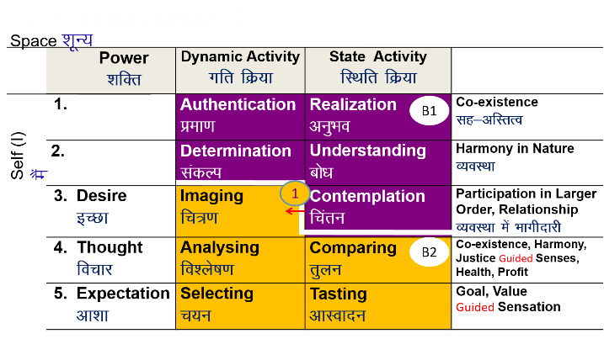
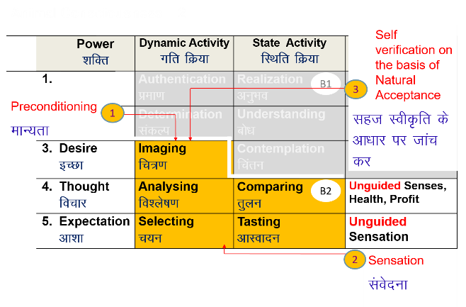
Human Education
Next generation has improved
- Understanding
- Feeling
Human Education
Personal Transformation
Societal Transformation
Transformation& Progress
laØe.k&fodkl

Slide 13
Harmony in the Society (lekt esa O;oLFkk)
Human Goal
Human Order ¼ekuoh; O;oLFkk½
Systems / Dimensions ¼vk;ke½
  1. Education – Sanskar
  2. Health – Self-regulation
  3. Production – Work
  4. Justice – Preservation
  5. Exchange – Storage
Right Understanding & Right Feeling
Prosperity
Fearlessness
(Trust)
Co-Existence
(mutual fulfilment)
Happiness
2
4
In Every Individual
In Every Family
In Society
In Nature/ Existence
1
2
3
4
2b. Self-regulation – Feeling of responsibility for Nurturing, Protection and Right Utilization of the Body
2a. Health (Swasthya) –
  Body acts according to Self (I)
  Parts of the body are in harmony (in order)
→ Recognising What is Needed as Physical Facility
2
4

Slide 14
Program for Health-Self Regulation
(A) For Staying Healthy
1a
  1 Intake and Routine (Lifestyle)
  2 Labour and Exercise
  3 Postures for regulating internal & external body organs and
  Regulated Breathing
  4 Medicine and Treatment
1
1b
2
(B) For bringing body back to harmony from temporary disharmony
3
(C) Dependence on drug / machine to perform a body function
1a. Intake includes air, water, sunlight, food (food is nutritious, digestible & tasty and waste is excretable), all intake through our senses (sound, sight, smell etc)
1b. Rising time, sleeping time, eating time…
2a. Outcome of labour is production of physical facility
2b. No physical facility is produced by exercise

Slide 15
System for Health-Self-regulation at various Levels
Level Program
Individual Lifestyle, exercise
Family Intake, daily routine
Family cluster Postures, Regulation of breath
Village Medicine
Village cluster / city Health education, environment, labour, treatment
…
Nation Proliferation of good practices
…
World Humane culture, civilisation, tradition
More research is required for this societal system / dimension

Slide 16
Harmony in the Society (lekt esa O;oLFkk)
Human Goal
Human Order ¼ekuoh; O;oLFkk½
Systems / Dimensions ¼vk;ke½
  1. Education – Sanskar
  2. Health – Self-regulation
  3. Production – Work
  4. Justice – Preservation
  5. Exchange – Storage
Right Understanding & Right Feeling
Prosperity
Fearlessness
(Trust)
Co-Existence
(mutual fulfilment)
Happiness
2
4
In Every Individual
In Every Family
In Society
In Nature/ Existence
1
2
3
4
2
4
3b. Work: The labour a human being does on the rest of nature
3a. Production: The physical facility obtained out of work

Slide 17
Behaviour Work
With human being
Return of behaviour =
right understanding, right feeling, right thought
Mutual happiness
With rest of nature
Return of work =
physical facility
Mutual prosperity

Slide 18
Production
1. Primary production of physical facility used for nurturing, protection & right utilisation of body
eg. Food, clothes, shelter…
2. Secondary Production of physical facility used to facilitate primary production
eg. Tractor…
3. Tertiary Production of physical facility used to facilitate production, services & behaviour
eg. Train, TV, Mobile…
4. Services to facilitate any of the above production
eg. Tractor maintenance, software for mobile
Priority order = 1, 2, 3, 4? Or 4, 3, 2, 1?

Slide 19
Harmony in the Society (lekt esa O;oLFkk)
Human Goal
Human Order ¼ekuoh; O;oLFkk½
Systems / Dimensions ¼vk;ke½
  1. Education – Sanskar
  2. Health – Self-regulation
  3. Production – Work
  4. Justice – Preservation
  5. Exchange – Storage
Right Understanding & Right Feeling
Prosperity
Fearlessness
(Trust)
Co-Existence
(mutual fulfilment)
Happiness
3
In Every Individual
In Every Family
In Society
In Nature/ Existence
1
2
3
4
4a. Justice – Recognition of Human-Human Relationship, its Fulfillment & Evaluation leading to Mutual Happiness
3
Notes:
* U;k; lqj{kk& f}rh; egRoiw.kZ vk;ke
U;k;¾ekuo&ekuo laca/k dh igpku] fuokZg]mHk; lq[k
lqj{kk¾ekuo&”ks’k izd`fr laca/k dh igpku] fuokZg]mHk; le`f)
U;k; lqj{kk dh ftEesnkjh gj O;fDr dh gS] ifjokj dh gS] lekt dh gS vkSj varr% jkT; dh gSA
lekt o jkT; esa U;k; lqj{kk dks lqfuf”pr djus dh ftEesnkjh “kklu&iz”kklu dh gSA
jkT; esa vxj U;k;] lqj{kk dh lqfuf”prrk u gks ik;] vogsyuk gks] foijhr gks rks
ml vU;k;] vlqj{kk dks jksdus dh ftEesnkjh U;k;ikfydk o iqfyl dh gSA
U;k; lqj{kk dks lqfuf”pr djus esa “kklu&iz”kklu dk lg;ksx djus dh ftEesnkjh iqfyl dh gSA
U;k; D;k gS\&bls le>uk vko”;d gSA&laca/k] Hkko ewY;&fo”okl] lEeku
lqj{kk D;k gS\ &ijLijiwjdrk
D;k gesa U;k; dh Li’Vrk gS\
D;k ge U;k;iwoZd th jgs gS &Lo;a esa lgh Hkko gS
ifjokj esa lgh Hkko gS] mldk fuokZg dj mHk; lq[k gks jgk gS
fe=ksa esa] lgdfeZ;ksa esa lgh Hkko gS] mldk fuokZg dj mHk; lq[k gks jgk gS
&lekt esa U;k;iwoZd th ik jgs gSa\
&lekt esa vU;k; dks jksd ik jgs gSa\
;gh lc iz”u lqj{kk dks ysdj Hkh gSaA

Slide 20
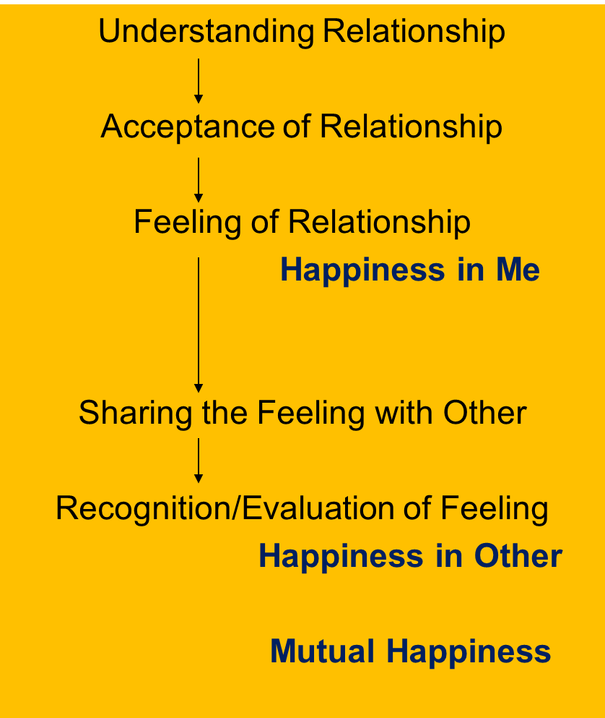
Harmony in Family – Justice, From Family to World Family (Undivided Society)
Relationship is – between one self (I₁) and other self (I₂)
There are feelings in relationship – in one self (I₁) for other self (I₂)
These feelings can be recognized – they are definite (9 Feelings)
Their fulfilment, evaluation leads to mutual happiness
Feelings in relationship:
Justice = Recognition, Fulfillment & Evaluation of
Human-Human Relationship, leading to Mutual Happiness
Justice → from Family to World Family
→ Undivided Society ¼v[k.M lekt½
1- Trust fo”okl FOUNDATION VALUE
2- Respect lEeku
3- Affection Lusg
4- Care eerk
5- Guidance okRlY;
6- Reverence J)k
7- Glory xkSjo
8- Gratitude —rKrk
9- Love izse COMPLETE VALUE

Slide 21
Self Reflection
What is required for justice in the society? At each level
Family level… neighborhood… institution… city… district… state… nation… world
Like that, clarity of the base as well as details are essential for a humane society to materialize
Most importantly, our meaningful participation in one or more societal systems / dimensions is expected

Slide 22
Harmony in the Society (lekt esa O;oLFkk)
Human Goal
Human Order ¼ekuoh; O;oLFkk½
Systems / Dimensions ¼vk;ke½
  1. Education – Sanskar
  2. Health – Self-regulation
  3. Production – Work
  4. Justice – Preservation
  5. Exchange – Storage
Right Understanding & Right Feeling
Prosperity
Fearlessness
(Trust)
Co-Existence
(mutual fulfilment)
Happiness
4
In Every Individual
In Every Family
In Society
In Nature/ Existence
1
2
3
4
4b. Preservation – Recognition of Human-Rest of Nature Relationship, its Fulfillment & Evaluation leading to Mutual Prosperity or Mutual Enrichment
Prosperity of Human Being
Enrichment, Protection & Right Utilisation of rest of Nature
4

Slide 23
Harmony in the Society (lekt esa O;oLFkk)
Human Goal
Human Order ¼ekuoh; O;oLFkk½
Systems / Dimensions ¼vk;ke½
  1. Education – Sanskar
  2. Health – Self-regulation
  3. Production – Work
  4. Justice – Preservation
  5. Exchange – Storage
Right Understanding & Right Feeling
Prosperity
Fearlessness
(Trust)
Co-Existence
(mutual fulfilment)
Happiness
2
3
In Every Individual
In Every Family
In Society
In Nature/ Existence
1
2
3
4
5a. Exchange – of physical facility with a view of mutual fulfillment
(not with obsession for profit / of exploitation)
5b. Storage – of physical facility with a view of mutual fulfillment
(not with obsession for profit / of accumulation)
2
3

Slide 24
Developmental Economics = ?
Take-Take Economics (dominate/exploit HB, exploit rest of nature)
Feeling: opposition
Result: both try to maximise their share (profit maximisation)
Needs are undefined / unlimited + resources are limited → Everyone is bound to be deprived
Give-Take Economics
Feeling: indifferent or opposition
Give-Give Economics (both work for mutual fulfilment and enrichment)
Feeling: Relationship
1. Identify the needs → Needs are definite
2. Produce more than what is required by cyclic, mutually enriching process
(more is for sharing in relationship, for order in the society)
→ Resources are more than required
Every family (all) can be prosperous

Slide 25
Harmony in the Society (lekt esa O;oLFkk)
Human Goal (ekuo y{;)
Human Order ¼ekuoh; O;oLFkk½
Systems / Dimensions ¼vk;ke½
  1. Education – Sanskar
  2. Health – Self-regulation
  3. Production – Work
  4. Justice – Preservation
  5. Exchange – Storage
Right Understanding & Right Feeling
Prosperity
Fearlessness
(Trust)
Co-Existence
(mutual fulfilment)
1
Happiness
2
3
4
In Every Individual
In Every Family
In Society
In Nature/ Existence
1
2
3
4
1
2
4
3
4
2
3

Slide 26
Harmony in Society – Universal Human Order
Human Goal (ekuo y{;)
Systems / Dimensions of Human Order ¼ekuoh; O;oLFkk& vk;ke½
  1. Education – Sanskar - f”k{kk laLdkj
  2. Health – Self-regulation - LokLF; la;e
  3. Production – Work - mRiknu dk;Z
  4. Justice – Preservation - U;k; lqj{kk
  5. Exchange – Storage - fofue; dks’k
Scope –From Family Order to World Family Order (Universal Human Order)
Family – Family cluster – Village – Village cluster ... Nation ... World Family
Order Order Order Order Order Order
~10¹ ~10² ~10¹⁰
Right Understanding & Right Feeling
Prosperity
Fearlessness
(Trust)
Co-Existence
(mutual fulfilment)
Happiness
In Every Individual
In Every Family
In Society
In Nature/ Existence

Slide 27
Scope Example in India Education Health Justice Production etc.
Individual 131 Crore (2020)
1-Family 25 Crore
2-Family Cluster
3-Village 7 Lakh 90% 90% 90% 90% 90%
4-City / Village Cluster
5-Region
6-Mandal
7-Mandal Cluster
8-State
9-Nation 1
10-World

Slide 28
Scope: Example in Bhutan 2016
Individual 7.8 lakhs
1-Family 56,000 households
2-Village 4,500
Thromdes (muncipality)
3-Chiwog (village cluster) 1,044
4-Gewog (village block) 205 (avg. 230 km² / Gewog)
Dunkhag (sub district)
5-Dzongkhag (district) 20
6-Nation Family 1
World Family

Slide 29
Sum Up
A society is composed of families living together, in a relationship of mutual fulfillment. They have a common goal, which is:
    Right understanding & right feeling (happiness) in every individual
    Prosperity in every family
    Fearlessness (trust) in society
    Co-existence (mutual fulfilment) in nature/existence
The family is the basic unit in society, i.e. society is composed of family, group of families, village family, group of village families, town family… and so on, where every individual is responsible or self-disciplined and self motivated by common values, participating in the larger order toward a common human goal
Through the participation of every family in the society, in the 5 dimensions or social systems, the common human goal is fulfilled for all
    – from family order to world family order
    – generation after generation
[the current civilization is largely based on the assumption that human being = body, happiness is derived primarily from sensual pleasure & feeling from other; and hence accumulation of physical facility, domination and exploitation is at the core of the socio-economic systems]
1. Education – Sanskar
2. Health – Self-regulation
3. Production – Work
4. Justice – Preservation
5. Exchange – Storage

Slide 30
Harmony in the Society – Universal Human Order
Human Goal
(ekuo y{;)
Human Order ¼ekuoh; O;oLFkk½
Systems / Dimensions ¼vk;ke½
  1. Education – Sanskar
  2. Health – Self-regulation
  3. Production – Work
  4. Justice – Preservation
  5. Exchange – Storage
Scope –From Family Order to World Family Order (Universal Human Order)
Family – Family cluster – Village – Village cluster/city ... Nation ... World Family
Order Order Order Order Order Order
~10¹ ~10² ~10¹⁰
Right Understanding & Right Feeling
Prosperity
Fearlessness
(Trust)
Co-Existence
(mutual fulfilment)
Happiness
In Every Individual
In Every Family
In Society
In Nature/ Existence

Slide 31
Education Policies
- At Various Levels
(Family, Society, System)

Slide 32
Education at Society Level- Formal (School, College, University)
Formal process of teaching, learning and understanding things.

Slide 33
Education at Society level- Informal (publicity, performance, publication)
Media, television, drama and books…
Festivals and functions...
Publicity, performance and publication can not be the main process of education though…

Slide 34
Education at the level of System
Education for All: Education is the basic requirement of every individual.
Therefore, every human being needs to have proper opportunity to get education.
Policies for Human Education (education for value based living)
It needs to be decided as to what favourable conditions have to be provided for every child so as to give opportunity for education to everyone.
It should be properly expanded in the policy e.g. what and how much to be provided at which level.
  Primary school may be at village level, secondary school may be among 2-4 villages.
  Research facilities may be established among 10-20 villages.

Slide 35
Priority in Education Policy
Content and Method of education needs to be humane
Every person needs to have the opportunity and favourable conditions to get the required education.
All supporting facility for education needs to be available

Slide 36
Responsibility – Society and System
Society and system are to be jointly responsible for providing all these things required for education.
It has to be ensured in this sense that education is the need of the society and the next generation.
In the absence of this, it has become the responsibility of Individual to ensure education for himself or his children.
As a result, it has become a business to earn, and not the responsibility.

Slide 37
Potential Process of Transforming Education

Slide 38
One Possible Way
We are discussing about one possible way of going about
this transformation process in education,
which has been tried over last four decades, and
which seems to be working.

Slide 39
Step 1: Mass Awareness
Conferences, workshops and discussions with a view to facilitate self-exploration about a holistic perspective with:
  Family members
  People who have interest and readiness for purposeful social effort and social development
  Educators, teacher and education administrators
  Policy makers and people connected to governance
  Colleagues at work

Slide 40
Step 1: Awareness / Orientation Programs in Institutions
Short workshops for decision makers (members of the board, VC, deans…) and faculty members
Initial faculty development for selected faculty (1-day, 3-days, 8-days)
Incorporating UHV orientation in the Student Induction Program
Short workshops / awareness programs for all faculty, staff
Weekly meetings
Identify faculty, staff, spouses and others who are potential facilitators. Send them for FDPs – develop resource persons

Slide 41
Step 1: Personal Transformation
Self-verification → Listening, remembering to UNDERSTANDING
Self-awareness → Being aware of the INSIDE
(as well as the OUTSIDE)
Self-evaluation → Sorting out what is worth and what is not

Slide 42
Step 2: Incorporate UHV in the Academic Curriculum
Foundation course on Universal Human Values and Ethics
  Weekly meetings of faculty, students
  Mentorship of students by faculty / senior students
  Social projects, socially relevant final year projects
  Social internship
Higher level courses on Universal Human Values / Elective courses
  Understanding the human being
  Understanding co-existence
  Human relationships, values and ethical human conduct
  Universal human order
Value based streams of education
  Technologies and Systems for Holistic Development (B Tech / M Tech equivalent)
  Management by Relationship (MBA equivalent)
  Holistic Human Health (MBBS equivalent)

Slide 43
Step 2: Incorporate UHV in the Academic Curriculum
Requisite support and policy initiatives by monitoring agencies, such as MHRD, UGC, AICTE, ICMR, University Board of Governors and Academic Councils and School Education Boards will be helpful.
Strengthen Faculty Development Programs on a large scale with adequate development of resource material. This can be actualised by establishing human values resource centres at the regional and national (international) levels.
Provide adequate thrust to R&D dedicated towards transforming the whole mainstream education into humanistic education (value-based education). This is going to be a long-drawn process. However, it is indispensable.
Recognise value based streams of education for teaching / professional development requirements

Slide 44
Step 2: Foundation Course
Syllabus
Faculty development program – 8 days
Teaching material
    Teacher’s Manual (lecture plan for 28 lectures & 14 practice sessions)
    Textbook
    Presentations (PPTs)
    Video of all 28 lectures
    Web site AKTU http://aktu.uhv.org.in/
Examination and evaluation
Higher level courses for faculty development

Slide 45
Other Modes of
Transforming Education

Slide 46
Intervention in the Current System
Every institute has to define its vision and Mission
Can the vision and mission be as per the human goal?
  Let us think about it
The accreditation agencies like NBA and NAAC prescribe for Outcome Based Education.
5 out of 12 outcomes directly relate to the Right Understanding and Right Feeling

Slide 47
Program Outcomes in Engineering
1. Engineering knowledge
2. Problem analysis
3. Design/development of solutions
4. Conduct investigations of complex problems
5. Modern tool usage
6. The engineer and society
7. Environment and sustainability
8. Ethics
9. Individual and team work
10. Communication
11. Project management and finance
12. Life-long learning
Directly Related to
Right Understanding
and
Right Feeling

Slide 48
NAAC Criterion 7.1 Institutional Values and Social Responsibilities
Gender Equality (10)
7.1.1 Total number of gender equity sensitization programmes organized by the Institution during the last five years. (5)
7.1.2 Measures initiated by the Institution for the promotion of gender equity during the last five years. (5)
Environmental Consciousness and Sustainability (10)
7.1.3 The Institution has facilities for alternate sources of energy and energy conservation devices (3)
7.1.4 Describe the facilities in the Institution for the management of the following types of degradable and non-degradable waste (within 500 words) (3)
7.1.5 Water conservation facilities available in the Institution(3)
7.1.6 Green campus initiatives of the Institution include (2)
Differently-abled (Divyangjan) friendliness (10)
7.1.7 The Institution has disabled-friendly, barrier-free environment in the campus (10)
Inclusion and Situatedness (10)
7.1.8 Describe the Institutional efforts/initiatives in providing an inclusive environment i.e., tolerance and harmony towards cultural, regional, linguistic, communal socio-economic and other diversities. (10)
Human Values and Professional Ethics (10)
7.1.9 Code of conduct handbook exists for students, teachers and academic and administrative staff including the Dean / Principal /Officials and support staff.(6)
7.1.10 The Institution celebrates / organizes national and international commemorative days, events and festivals (4)

Slide 49
Bloom’s Taxonomy
Bloom’s taxonomy is considered as the global language for education.
Bloom’s Taxonomy is used by teachers in writing the course outcomes.

Slide 50
The Three DOMAINS
Affective
Includes the manner in which we deal with things emotionally (ex: feelings, appreciations, etc.)
- Related to Natural Acceptance
Cognitive
Involves knowledge and the development of intellectual skills. (ex: recognition of specific facts)
- Related to Imagination, i.e. Desire, Thought and Expectation
Psychomotor
Involves physical movement, coordination, and use of the motor skills (ex: perception, response)
- Related to Behavior and Work

Slide 51
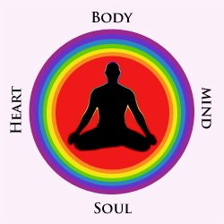
HOLISTIC EDUCATION as per Bloom’s Taxonomy
Instrument of the Self
Desire, Thought,
Expectation
(in the Self)
Feelings
(in Relationship)
Natural Acceptance

Slide 52
What is Affective Domain?
The affective domain is concerned with the attitudes and feelings that result from the learning process
  Motivations
  Moods
  Feelings
  Emotions
  Attitudes
  Beliefs / Values

Slide 53
Affective Domain
Skills in the affective domain describe the way people react emotionally and their ability to feel another living thing's pain or joy. Affective objectives typically target the awareness and growth in attitudes, emotion, and feelings. There are five levels in the affective domain moving through the lowest order processes to the highest:

Slide 54
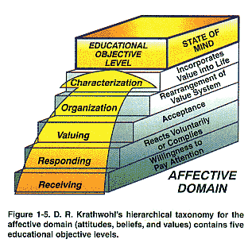
AFFECTIVE DOMAIN (ATTITUDE)
We need to intervene here in the Affective Domain at the Policy Level

Slide 55
Original
Revised
Evaluation
Synthesis
Analysis
Application
Comprehension
Knowledge
Creating
Evaluating
Analyzing
Applying
Understanding
Remembering
Noun
Verb
Notes:
Remembering = Rote memorization
Classifying cognitive thinking into different levels, each building on the previous level, from the most simple to the most abstract
ORIGINAL = 8 years
REVISED = 6 years
Application (noun) to knowledge (verb)

Slide 56
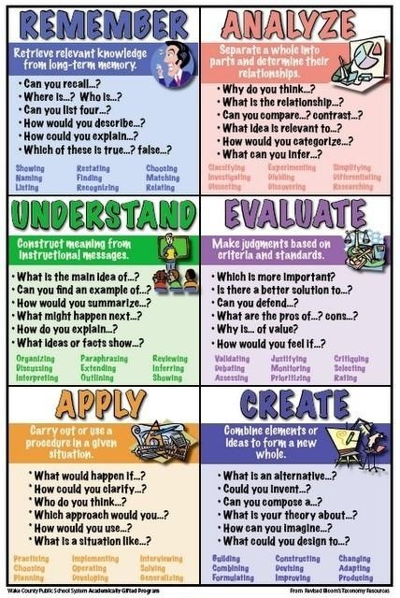
Summary
Notes:
GOLDILOCKS STORY

Slide 57
Cognitive
Domain
Affective
Domain
Psychomotor
Domain
Articulating
Imitating
Manipulating
Performing
Precisioning
Analyzing
Applying
Creating
Evaluating
Remembering
Understanding
Characterizing by value or value concept
Organizing &
conceptualizing
Receiving
Responding
Valuing
Notes:
THREE TYPES OF LEARNING:
COGNITIVE DOMAIN: Thinking, intellectual abilities. Comprehending information, organizing ideas, evaluating information and actions.
AFFECTIVE DOMAIN: A learner’s emotions toward learning. Interests, attitudes, opinions, appreciations, values, emotional sets.
PSYCHOMOTOR DOMAIN: Basic motor skills, coordination, and physical movement. Speech development, reading readiness, handwriting, physical education, manipulative skills (keyboarding), industrial technology, performance areas in science, art, music.
American education has been leaning more toward the cognitive domain at the exclusion of the affective and psychomotor domains. Well-rounded and fully functioning people need development in all three domains.

Slide 58
Self Reflection

Slide 59
Self Reflection
What is the common goal of your family? Is achieving it discussed periodically? How does it map to the Human Goal?
In your family, sit together and discuss
  the family goal
  the program for its fulfillment
  the role / participation of each of the family members in its fulfillment
  the state of the fulfillment of the goal (evaluation)

Slide 60
Self Reflection
What is the common goal of the organization you belong to? How does it map to the Human Goal?
How can you and your organization contribute for ensuring right understanding and right feeling in the neighborhood of the institution?

Slide 61
Key Points
Lecture 18: Vision for the Universal Human Order

Slide 63
Harmony in Society – Universal Human Order
Human Goal (ekuo y{;)
Systems / Dimensions of Human Order ¼ekuoh; O;oLFkk& vk;ke½
  1. Education – Sanskar - f”k{kk laLdkj
  2. Health – Self-regulation - LokLF; la;e
  3. Production – Work - mRiknu dk;Z
  4. Justice – Preservation - U;k; lqj{kk
  5. Exchange – Storage - fofue; dks’k
Scope –From Family Order to World Family Order (Universal Human Order)
Family – Family cluster – Village – Village cluster ... Nation ... World Family
Order Order Order Order Order Order
~10¹ ~10² ~10¹⁰
Right Understanding & Right Feeling
Prosperity
Fearlessness
(Trust)
Co-Existence
(mutual fulfilment)
Happiness
In Every Individual
In Every Family
In Society
In Nature/ Existence

Slide 64
Sum Up
A society is composed of families living together, in a relationship of mutual fulfillment. They have a common goal, which is:
    Right understanding & right feeling (happiness) in every individual
    Prosperity in every family
    Fearlessness (trust) in society
    Co-existence (mutual fulfilment) in nature/existence
The family is the basic unit in society, i.e. society is composed of family, group of families, village family, group of village families, town family… and so on, where every individual is responsible or self-disciplined and self motivated by common values, participating in the larger order toward a common human goal
Through the participation of every family in the society, in the 5 dimensions or social systems, the common human goal is fulfilled for all
    – from family order to world family order
    – generation after generation
[the current civilization is largely based on the assumption that human being = body, happiness is derived primarily from sensual pleasure & feeling from other; and hence accumulation of physical facility, domination and exploitation is at the core of the socio-economic systems]
1. Education – Sanskar
2. Health – Self-regulation
3. Production – Work
4. Justice – Preservation
5. Exchange – Storage

Slide 65
FAQs for Lecture 18
Vision for the Universal Human Order

Slide 66
Question(s): Response
What is the right age to start value education? I am asking because children don't have the capacity to think so deeply and evaluate all these proposals. Is there a different process of learning for adults and a different process for children?
For a child to live with definite human conduct, the parents need to have right understanding so that they are able to give the right sanskar to the child. Thus the preparation for educating the child can start before it took birth.
Since childhood, the children are observing their parents, and getting conditioned or educated. Hence, value education has already started.
The process is the same for all: self-exploration. And with children, we get very straightforward answers.

Slide 67
Child’s Desire / Expectation Fulfillment / Satisfaction Point
Expectation for justice
(न्याय का याचक)
    In every interaction
2. Desire for right work & behaviour
(सही कार्य व्यवहार का इच्छुक)
    The child naturally wants to participate, makes effort to learn & can learn
Speaks the truth
(सत्यवक्ता)
    The child naturally speaks whatever truth it knows
    It willingly makes effort to understand, asks lots of questions
    It can understand
    Ability to do justice
    (न्यायप्रदाई क्षमता)
    Competence for right work & behaviour
    (सही कार्य व्यवहार करने कि योग्यता)
    Understanding the truth
    (सत्यबोध)
    from self to entire existence
    The child expects parents, elders, teachers, society… to facilitate it to attain the satisfaction point (role of education-sanskar)

Slide 68
Question(s): Response
Are we talking about having equal physical facilities for all? Or is it that I can have a different need and someone else can have a different need? After all, we have to calculate the amount of money required for living and all kinds of emergencies.
We are not talking about having equal physical facilities. We are talking about the feeling of prosperity. And for that everyone needs to make out the need for physical facility clearly.
To make out the need for physical facilities, we need to understand clearly the needs of self and body.

Slide 69
Question(s): Response
There are so many problems in the society, and our effort will take a long time to make an impact in the society. Don’t you think that a revolution is required?
There are four things:
1. Clarity of all-encompassing solution (samadhan)
2. Effort to materialize the solution
3. Appraisal of the current state of problems
4. Effort to remove the problems.
Many a times, we start from 3 and go for 4 without working for 1 and 2. And then we may create more problems than solutions.
We first need to fix our program for realizing the human goal. In that process, we will be in a better position to evaluate the current state and work to remove the current problems.

Slide 70
Question(s): Response
There is so much disparity today in the society. There is a vast gap between haves and have-not’s. How does this proposal seem to address this gap?
We need to understand that the basic aspiration is continuity of happiness and prosperity. And this is ensured by right understanding and right feelings. It is not determined by the possession of physical facilities.
So whether one belongs to the category of haves or have-not’s, what essentially matter is the correct recognition of need for physical facilities which is possible through right understanding and right feeling.

Slide 71
Question(s): Response
At one point of time, we were living peacefully in our country. And then were invaded from outside the country, and got enslaved. Even if we are able to make this program effective, what is the guarantee that this will not happen again?
We are talking about undivided society. We discussed the steps for self-organization of world family. And when the content of education is universal, it is going to be accepted by all.

Slide 72
Question(s): Response
How do we plan to transition from value education to value based education?
To have value based education, we need to base the content in every course on right understanding and right feeling.
In the present system, there are several modes available. We can redefine the graduate attributes in our courses. At the level of institution, we can set a holistic vision and mission, and so on.

